Slide 1
FUNDAMENTALS OF SOFTWARE PROJECT MANAGEMENT Estimation
Week-8

Slide 2
Objectives
Estimation
taxonomy of Estimation Methods
Top-down
Bottom-up - activity based, analytical
Parametric or algorithmic models e.g. function points (using formulas and equations)
Expert opinion - just guessing?
Analogy - case-based, comparative
Parkinson and ‘price to win’
Parametric or algorithmic models e.g. function points (using formulas and equations)
Productivity
Function Point
Cocomo-I

Slide 3
Parametric models
Four parametric models:
Albrecht/IFPUG function points
Symons/Mark II function points
COSMIC function points
COCOMO81 and COCOMO II
Notes:
Recall that function points model system size, while COCOMO focuses on productivity factors.

Slide 4
Albrecht/IFPUG function points
Albrecht worked at IBM and needed a way of measuring the relative productivity of different programming languages.
Needed some way of measuring the size of an application without counting lines of code.
Identified five types of component or functionality in an information system
Counted occurrences of each type of functionality in order to get an indication of the size of an information system
Notes:
Different programming languages have different degrees of ‘power’ which relate to the ratio between the length of programming commands and the amount of processing they create. This is analogous to trying to assess the productivity of bricklayers where different bricklayers work with bricks of different sizes. One way of dealing with this problem is to say that what is important is the size of the wall being built not the number of bricks it contains. FPs are way of measuring the amount of functionality in an application without counting the lines of code in the application.

Slide 5
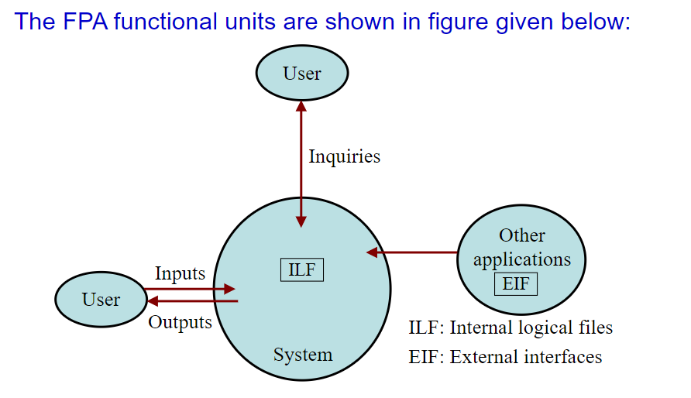

Slide 6
Albrecht/IFPUG function points - continued
Five function types
Logical interface file (LIF) types – equates roughly to a datastore in systems analysis terms. Created and accessed by the target system
External interface file types (EIF) – where data is retrieved from a datastore which is actually maintained by a different application.

Slide 7
Albrecht/IFPUG function points - continued
External input (EI) types – input transactions which update internal computer files
External output (EO) types – transactions which extract and display data from internal computer files. Generally involves creating reports.
External inquiry (EQ) types – user initiated transactions which provide information but do not update computer files. Normally the user inputs some data that guides the system to the information the user needs.
Notes:
Section 5.10 Page 114

Slide 8
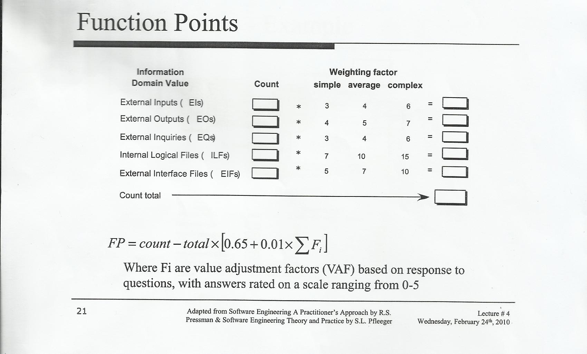
Function Point
FP= UFP * VAF

Slide 9
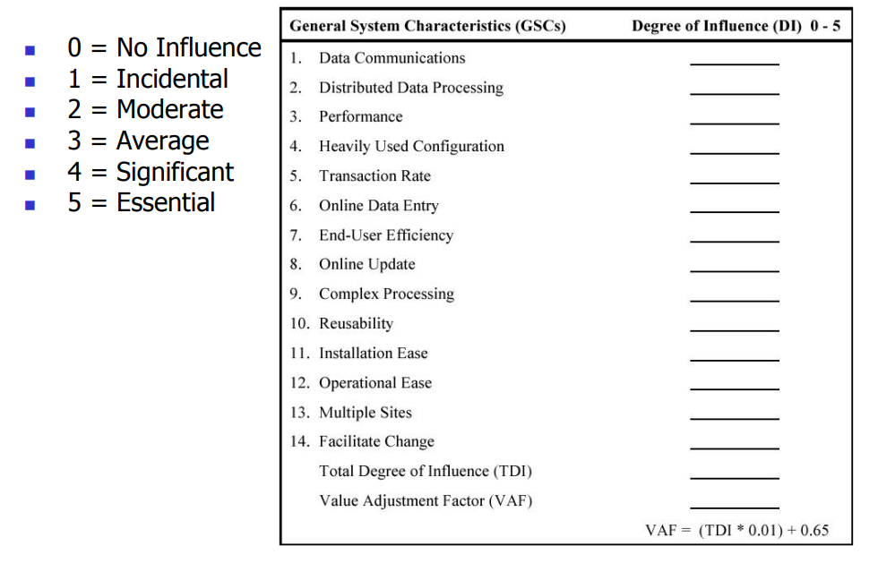
VAF Calculation

Slide 10
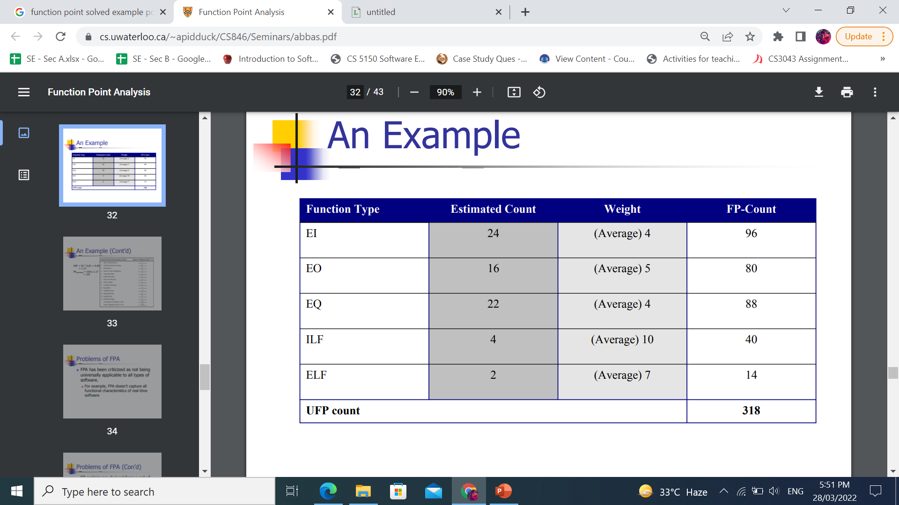
Example

Slide 11
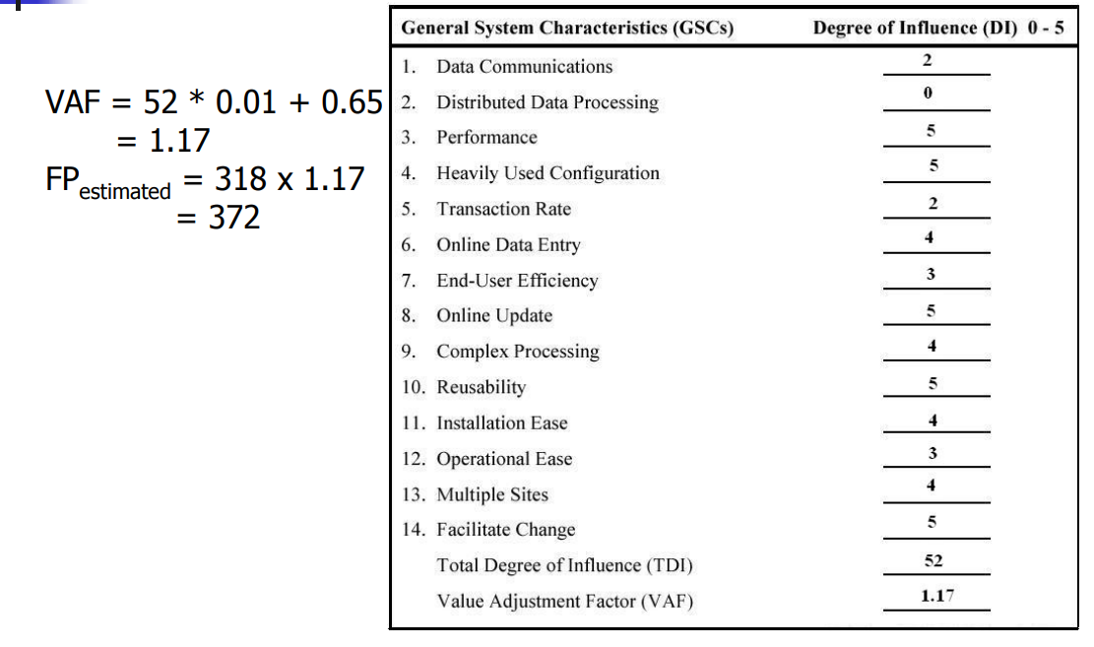
Example
VAF = (TDI * 0.01) + 0.65.

Slide 12
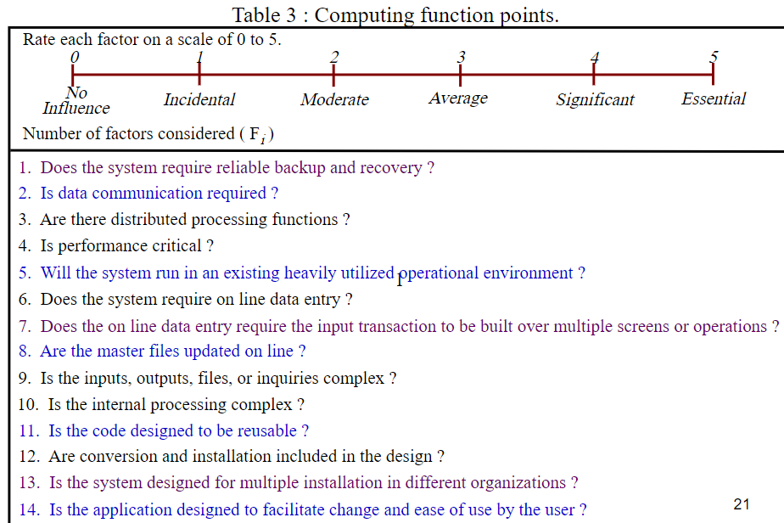

Slide 13
Function points Mark II
Developed by Charles R. Symons
‘Software sizing and estimating - Mk II FPA’, Wiley & Sons, 1991.
Builds on work by Albrecht
Work originally for CCTA:
should be compatible with SSADM; mainly used in UK
has developed in parallel to IFPUG FPs
A simpler method
Notes:
Once again, just a reminder that the lecture is just an overview of concepts. Mark II FPs is a version of function points developed in the UK and is only used by a minority of FP specialists. The US-based IFPUG method (developed from the original Albrecht approach) is more widely used. I use the Mark II version because it has simpler rules and thus provides an easier introduction to the principles of FPs. Mark II FPs are explained in more detail in Section 5.11. The IFPUG rules are really quite tricky in places and for the full rules it is best to consult IFPUG documentation.

Slide 14
Function points for embedded systems
Mark II function points, IFPUG function points were designed for information systems environments
COSMIC FPs attempt to extend concept to embedded systems
Embedded software seen as being in a particular ‘layer’ in the system
Communicates with other layers and also other components at same level
Notes:
Attempts have been made to extend IFPUG FPs to real-time and embedded systems, but this has not been very convincing (IMHO).
Embedded software component is seen as at a particular level in the system. It receives calls for services from a higher layer and requests services from lower layers. It will receive responses from lower levels and will send responses to higher levels.

Slide 15
COCOMO81
Based on industry productivity standards - database is constantly updated
Allows an organization to benchmark its software development productivity
Basic model
effort = c x size^{k}
C and k depend on the type of system: organic, semi-detached, embedded
Size is measured in ‘kloc’ ie. Thousands of lines of code
Notes:
Recall that the aim of this lecture is to give an overview of principles. COCOMO81 is the original version of the model which has subsequently been developed into COCOMO II some details of which are discussed in Section 5.13. For full details read Barry Boehm et al. Software estimation with COCOMO II Prentice-Hall 2002.

Slide 16
3 types of COCOMO:
1- Basic Cocomo Model
2- Intermediate Cocomo Model
3- Detailed Cocomo Model

Slide 17
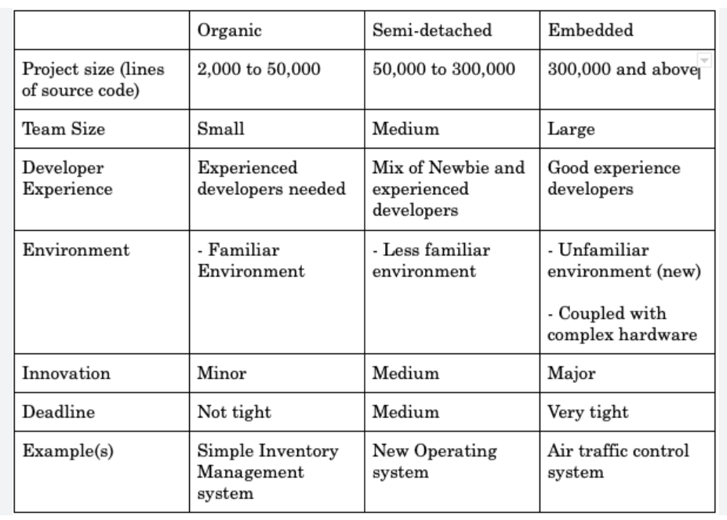
Difference

Slide 18
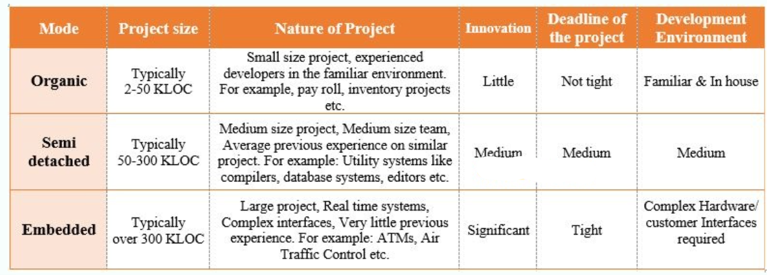
FYI:

Slide 19
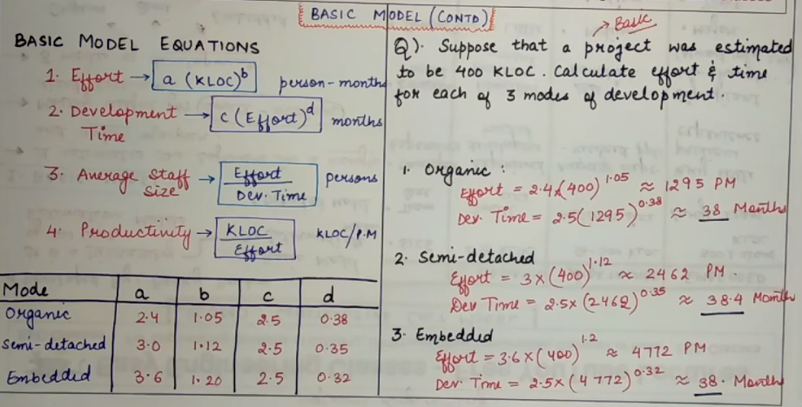
1- Basic Cocomo

Slide 20
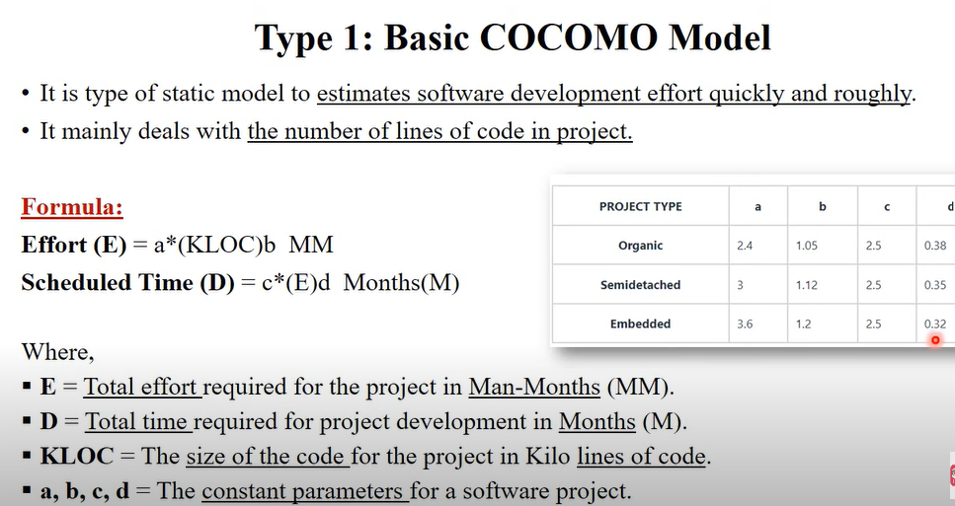
1- Basic Cocomo

Slide 21
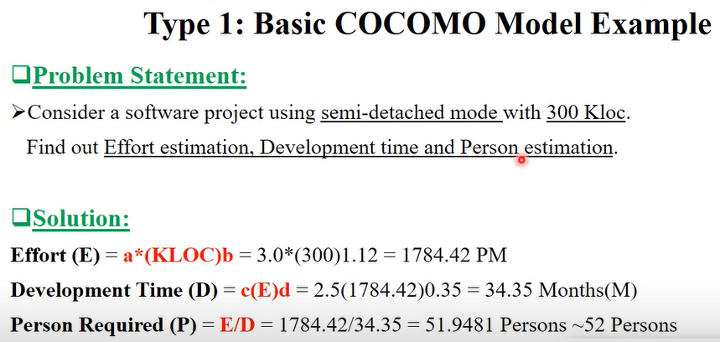
1- Example

Slide 22
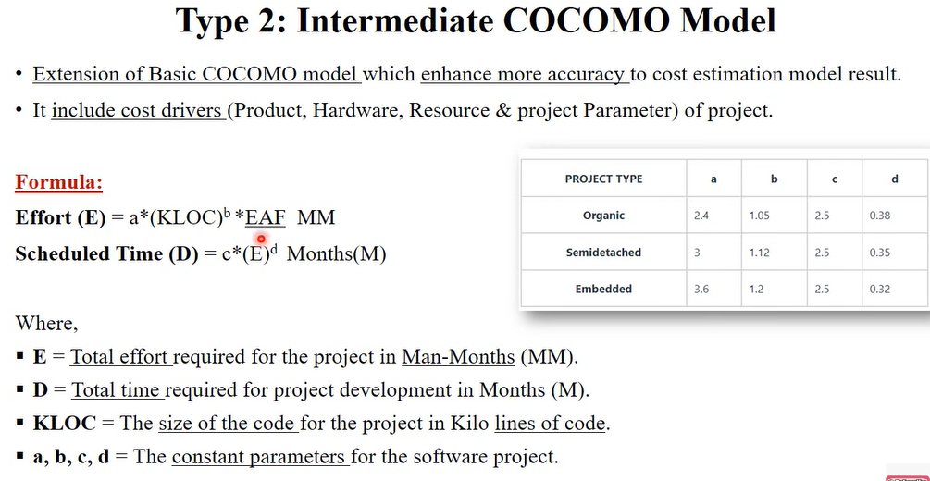
2- Intermediate Cocomo Model

Slide 23
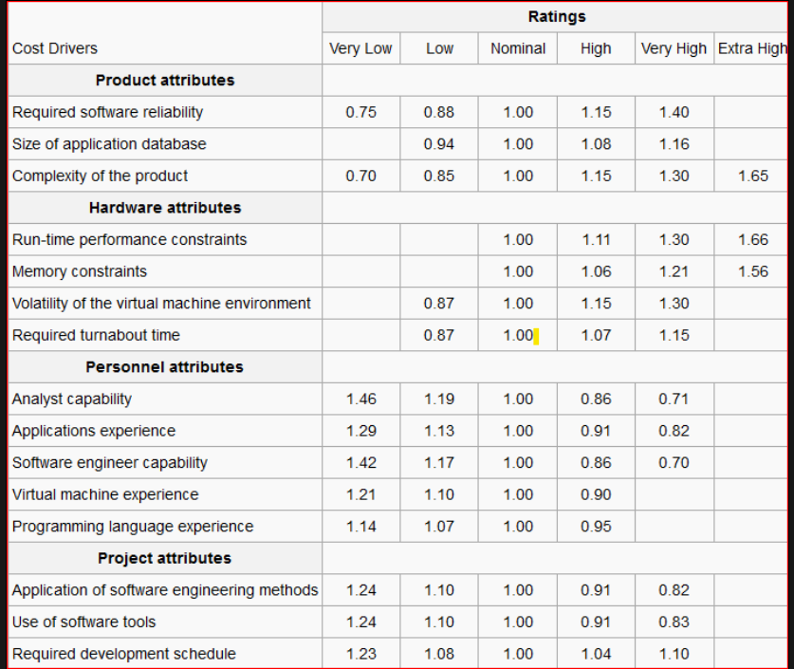
EAF Table

Slide 24
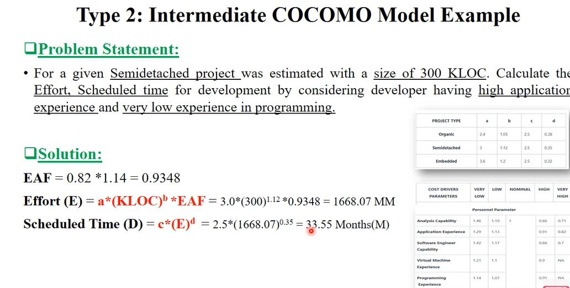
2- Example
Notes:
Each of these cost drivers is rated on a scale, such as Very Low, Low, Nominal, High, Very High, and Extra High, and has an associated numerical weight value (e.g., 0.9, 1.0, 1.15, etc.).
The Effort Adjustment Factor (EAF) is calculated by multiplying the numerical values of all the cost drivers:

Slide 25
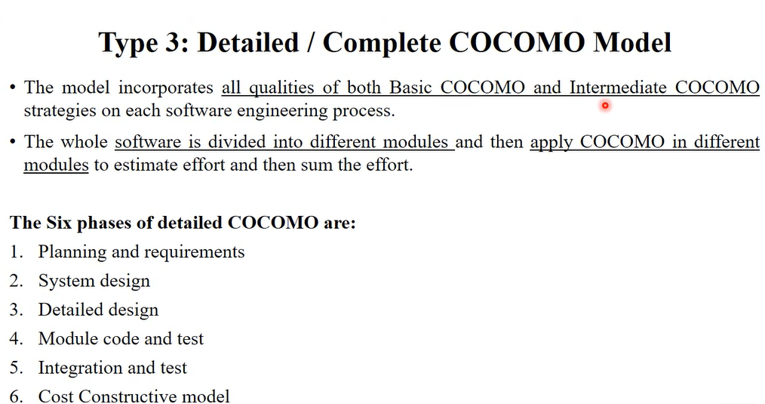
3- Detailed Cocomo Model

Slide 26
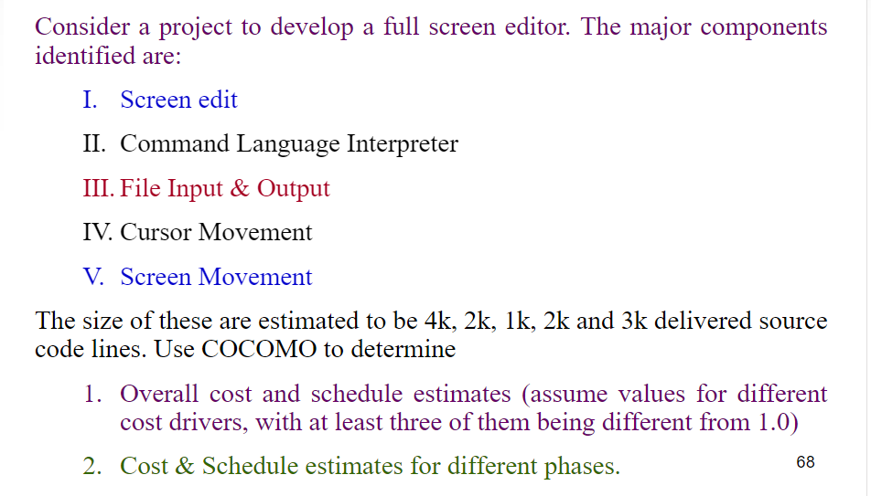
3- Example

Slide 27
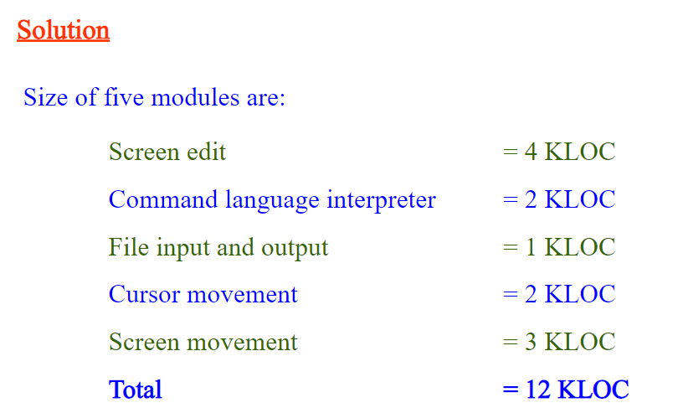
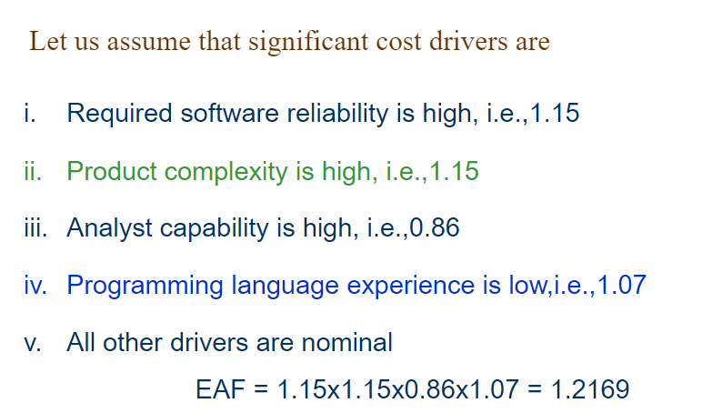

Slide 28
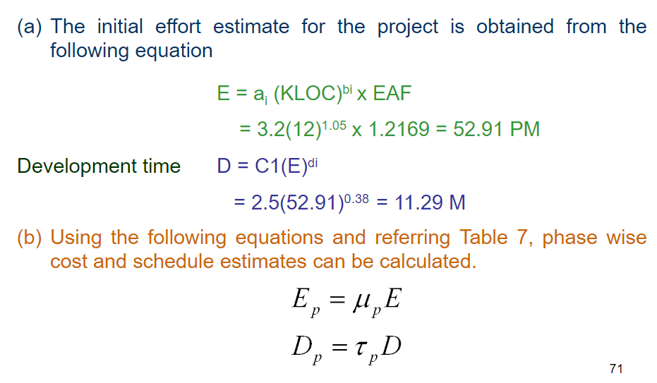

Slide 29
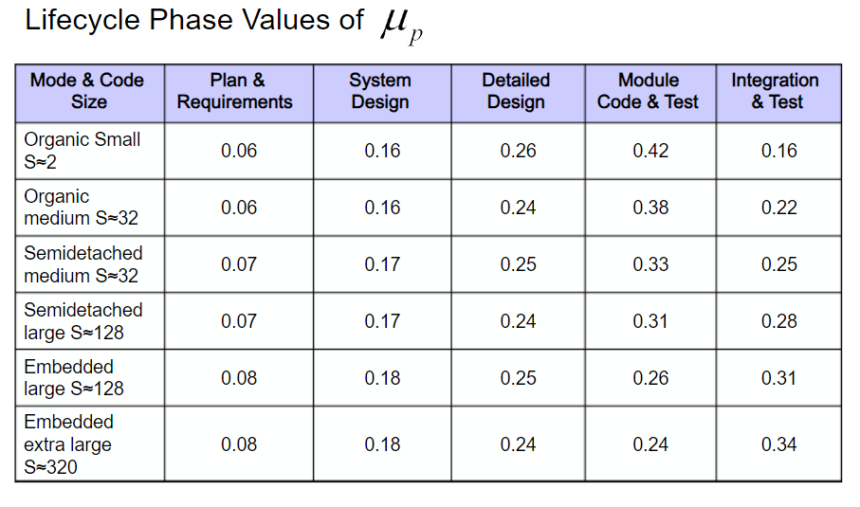

Slide 30
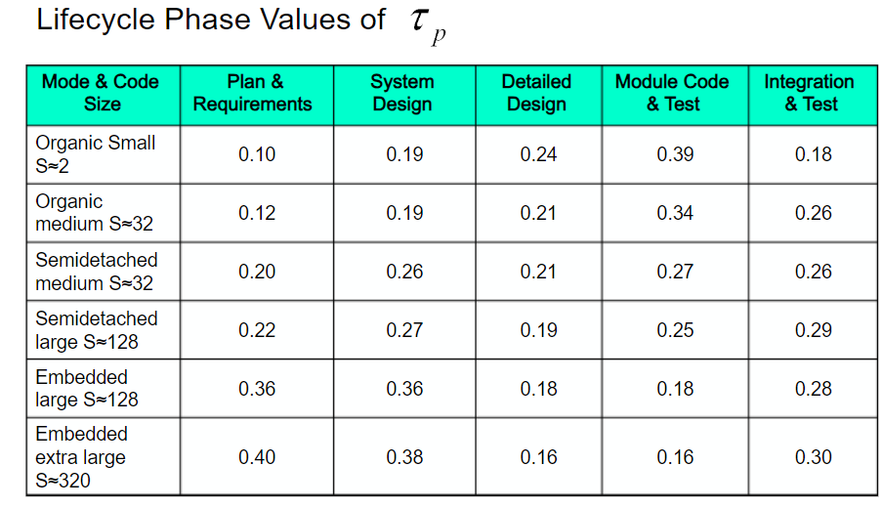

Slide 31
